Slide 1
Cross Sell and Up-Sell – Using Recommendation Engines, Affinity Analysis and Market Basket Analytics for Product Recommendation, to be used for existing customers

Slide 2

How Banks use ML to identify Cross-Selling and Upselling Opportunities
Dealing with customers can be challenging because of their changing patterns in behaviour
With the right approach, banks can evaluate their customers’ data and generate insights on cross-selling and upselling opportunities
They can also use that data to provide more personalized products and financial advice using ML techniques
Notes:
Image link: https://mapmycustomers.me/blog/the-importance-of-upselling-and-cross-selling-in-sales/
Notes:
Banks regularly create campaigns to offer new products to their customers. According to market research, it’s easier to sell a product to an existing customer than to sell a product to a new, qualified prospect. In today’s marketplace, banks provide a variety of deposit, lending, and investment products to individuals and businesses, but a good proportion of current customers might only use one or two of them. Because customers can pick the most affordable product from one bank and hunt for other products elsewhere, it can be challenging to sell a full range of financial products to a single customer. Fortunately, banks have a valuable asset: customer data. With the right approach, banks can evaluate their customers’ data and generate insights on cross-selling and upselling opportunities. They can also use that data to provide more personalized products and financial advice.This is where artificial intelligence (AI) comes in.
By identifying people who are open to cross-selling, banks are in a better position to increase their revenues.

Slide 3
How Banks use ML to identify Cross-Selling and Upselling Opportunities
Machine learning allows banks to evaluate buyer behaviour at the account level through an analysis of the most recent activities. For example – banks can personalize their products to a targeted group, which can improve a campaign’s return on investment
Machine learning also helps banks provide a better customer experience by anticipating a customer’s needs. For example, a customer who bought tickets to an overseas destination might receive a push notification on their mobile phone when they arrive at the airport for the best foreign exchange deals
Machine learning offers a much better solution for insightfully allocating marketing dollars than running financial marketing campaigns on underdeveloped research and half-baked ideas!
Notes:
Notes:
Banks are applying automation in their machine learning workflows for the following reasons:
Machine learning allows banks to evaluate buyer behavior at the account level through an analysis of the most recent activities. Instead of push-based selling or one-size-fits-all campaigns, banks can personalize their products to a targeted group, which can improve a campaign’s return on investment.
Machine learning helps banks provide a better customer experience by anticipating a customer’s needs. For example, a customer who bought tickets to an overseas destination might receive a push notification on their mobile phone when they arrive at the airport for the best foreign exchange deals. Or a customer who has encountered an unexpected expense might be offered an emergency loan at a competitive rate.
Machine learning isn’t a silver bullet for achieving cross-selling and upselling in banking. It can’t generate trustworthy insights for all customer behavior. That’s because customer behavior is affected by everything from the weather to the country’s politics. However, machine learning offers a much better solution for insightfully allocating marketing dollars than running financial marketing campaigns on underdeveloped research and half-baked ideas.

Slide 4
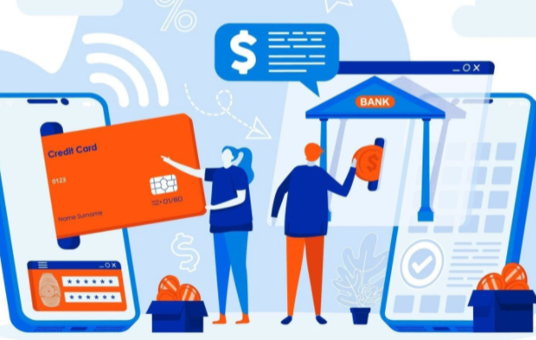
Predictive Analytics in cross selling and up-selling in banking
Push-based selling and “one-size-fits-all” campaigns might not suffice to lure the modern-day customer
They need access to valuable products, and they need it now
Any product you bundle with the rest of your financial offerings should add the most value to their lives
Notes:
Image link: https://www.vecteezy.com/vector-art/2314238-mobile-banking-web-design-concept-with-people-characters
Notes:

Slide 5
Predictive Analytics in cross selling and up-selling in banking
Banks use customer data to obtain insights from the following:
What customer to contact first
What to sell them
How to communicate with them
Predictive analytics allows banks to evaluate buyer behavior through recent account activities and sometimes even online activities such as reviews and complaints in order to provide them with personalized products
Notes:
Image link: https://mapmycustomers.me/blog/the-importance-of-upselling-and-cross-selling-in-sales/
Notes:
Given that banks collect data through CRM software and online tools, they can use this data to identify what their customers need. The data provides insights into:
What customer to contact first
What to sell them
How to communicate with them
Predictive analysis allows banks to evaluate buyer behavior through recent account activities and sometimes even online activities such as reviews and complaints. Instead of offering a single generalized offer, financial institutions can personalize their products to a specific prospect group which can improve a campaign’s return on investment.

Slide 6

Product Recommendation Engines in Banking
Several non-financial entities are coming up in the payments domain and each of these non-financial organisations has built a steady customer base and has powerful product recommendation engines
It is time for banks to get involved in a more personalized relationship with their customer by investing in powerful recommendation engines
51% of customers want powerful recommendation at traditional banks while 72% of millennials would be willing to look into non-financial entities like Amazon, Facebook, Google or Apple to satisfy their financial needs!
Notes:
Image link: https://www.datasciencecentral.com/profiles/blogs/top-9-data-science-use-cases-in-banking
Notes:
Currently, the banking environment is extremely volatile. Why? With several non-financial entities coming up in the payments domain, each of these non-financial organisations has built a steady customer base and has powerful product recommendation engines. Hence, it is time for banks to get involved in a more personalized relationship with their customer.

Slide 7
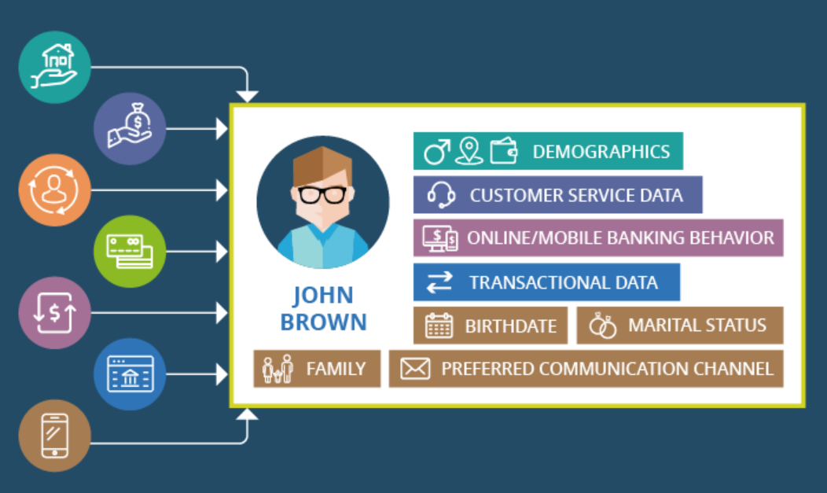
Product Recommendation Engines in Banking
For powerful recommendation engines, banks need immense amounts of customer data
Banks however, have to abide by a lot of compliance and regulations in the modern age. The financial data, which banks hold, or attempt to hold, is of immense importance to customers and hackers
It is extremely important for Banks to find the right balance between securing customer data and providing accurate and satisfying recommendations
Notes:
Image link: https://www.scnsoft.com/blog/how-to-create-a-single-view-of-the-customer-with-banking-software
Notes:
Firstly, for powerful recommendation engines, banks need immense amounts of customer data. Banks however, have to abide by a lot of compliance and regulations in the modern age. The financial data, which banks hold, or attempt to hold, classifies itself on the most interesting end of the data spectrum and is of immense importance to customers and hackers. Hence, customers would use the greater rights like Right to Forget as stated in the GDPR laws governing the European Union for such classified data. Banks know this, which makes it extremely important for them to find the right balance between securing customer data and providing accurate and satisfying recommendations.

Slide 8
Product Recommendation Engines in Banking
How it works:
Collect all the necessary data and spend time analysing it – there are three major types of customer data, which when referenced, provides for a plethora of insightful suggestions – Reference Data, Transactional Data and Social Data
Check for data integrity and completeness – Corrupted data, when fed into your machine-learning algorithm, affects the recommendation engine and provides a completely different and incorrect view of your customer
Obtain meaningful insights – A forecast model of the customer’s profitability can e drawn, customer segmentation, segregation based on risk score, etc.,
Notes:
Image link:
Notes:
1) Rule Number 1: Collect your data from every nook and corner and ANALYZE IT
On an average, data professionals spend only 40% of their time analysing data. However, more than 91% of top-level executives agree that data takes the highest priority in hacking customer experiences. Now, there are three major types of customer data, which when referenced, provides for a plethora of insightful suggestions. These 3 data types – Reference Data, Transactional Data and Social Data – are filtered by data analysts.
Reference Data gives information into the customer’s profile and general preferences. These data points always form the base of any customer data lake used in creating a recommendation engine. Transactional Data consists of data, which pinpoints to any customer behaviours in the form of payments and transactions. These data points could include transactional and complaints history, different agendas recorded from the customers’ visit to the bank and so on. Finally, Social Data adds flair to the entire data lake by giving a taste of the customers’ mood by collecting data from their social media engagements and activities online.
2) Rule Number 2: Governance and Integrity of your Data
89% of CIOs agree that bad data has been hurting their ability to provide enriched customer experiences. During the data ingestion process, it is highly likely that the data obtained would seem corrupted, incomplete and present with several outliers. Corrupted data, when fed into your machine-learning algorithm, affects the recommendation engine and provides a completely different and incorrect view of your customer.
The lack of measures to ensure data integrity would end up being disastrous for any bank, especially in the current highly competitive banking ecosystem. Besides this, there are many data dependencies within a database. This means that data completeness is crucial to make sense of the data. Each of these tasks requires people with adequate and high levels of technical knowledge, which is often not the case.
3) Insights
Product Recommendation Engines depend on the self-learning ability of machine learning algorithms. With sufficient and massive chunks of data on the customer, the process of deriving insights becomes easier.
A forecast model of the customer’s profitability through wealth management is drawn and the decision making process of the next best action takes place. Segmentation of customers into different classes at banks based on the loyalty quotient and products also takes place, which helps in better customer retention. Segregation of customers also takes place according to their credit risk score. This could help banks to segregate their customers accordingly and could recommend low-risk products for those customers.

Slide 9

Affinity Analysis for Banking
Affinity Analysis identifies your most profitable opportunities with your current customers (upsell and cross sell)
The data prep is almost non-existent, it will work with very small customer bases
Affinity Analysis can also be used to determine the value of any promotional offering or discount, or to evaluate product placement on web pages
Notes:
Image link: https://www.softwebsolutions.com/market-basket-analysis-for-retailers.html
Notes:

Slide 10
Affinity Analysis for Banking
How it works:
Evaluate the strength of the relationship between each of your products and every other product you offer – Example: what percent of customers with checking accounts also have auto loans?
Identify those pairings that have very strong affinity – Example: a customer with a credit card might be found to be twice or three times as likely to have an auto loan than an auto loan customer selected at random
Highlight customers who have one product of a strongly associated pair but not the other so that these specific customers can be targeted for cross sell and up sell opportunities
Notes:
Image link:
Notes:
Affinity Analysis does its work in three main steps:
1. Evaluate the strength of the relationship between each of your products and every other product you offer.
If this credit union has 20 products (checking, savings, check card, ATM, car loan, etc.) this means there are 380 two-product combinations (20 x 19) to evaluate. For example, what percent of customers with checking accounts also have auto loans.
2. Identify those pairings that have very strong affinity.
What we are most interested in are those pairings that are strongly associated. For example, a customer with a credit card might be found to be twice or three times as likely to have an auto loan than an auto loan customer selected at random.
3. Highlight customers who have one product of a strongly associated pair but not the other so that these specific customers can be targeted for cross sell and up sell opportunities.
This does not necessarily define a cause and effect relationship between the products and there may be perfectly good reasons the customer has not taken the other product. But these can be high probability opportunities.
Also, you should be aware that some strongly related product pairs will seem intuitively obvious while others may provide new insight. It may be completely obvious that ATM usage and Check Cards are strongly associated since Check Cards are typically provided as a means of ATM access. Not all findings may be actionable but chances are there will be several relationships you had not previously recognized.

Slide 11

Affinity Analysis for Banking
Affinity analysis and market basket analysis are mathematically the same
Since banking customers generally buy one thing at a time we’ll need to do this at the customer level, not the transaction level, so we deal with Affinity Analysis
But if we were talking about a business where customers bought many things at the same time (e.g. retail) we’d deal with Market Basket Analysis
Notes:
Image link: https://www.analyticsvidhya.com/blog/2021/05/introduction-to-affinity-analysis/
Notes:

Slide 12

Market Basket Analysis for Banking
Market Basket Analysis for Banking: when financial institutions want to dig deeper into the product-customer connection to serve the customer better, maximize value from targeted marketing and promote personalized experience
Serving the customer well is better achieved by keeping the customer at the forefront, rather than products
For example, banks that dip deep into customer connections and behaviours can tap into affinity analysis to unearth potential cross sell and upsell opportunities
Notes:
Image link: https://www.vecteezy.com/vector-art/2409479-email-advertising-campaign-concept-reaching-target-audience-with-emails-vector
Notes:
Banks and Market Basket Analysis can make up for an alluring pair. And ‘pairing of ‘products or service offerings’ raises in context when financial institutions want to dig deeper into the product-customer connection to serve the customer better, maximize value from targeted marketing and promote personalized experience.
In addition to the association unearthed between banking products, affinity analysis offers rich insights when significant customer information is included as part of the analysis. Serving the customer well is better achieved by keeping the customer at the forefront, rather than products, in this market basket analysis exercise.
Putting a customer-first face also means that banks read the need of the customer even before the customer realizes it. For one banks that offer a range of offerings from credit cards to investment schemes and insurance products can connect customer behaviors to the offerings and tap into affinity analysis to unearth potential cross sell and upsell opportunities.

Slide 13
Market Basket Analysis for Banking
With the customer-focus stitched into market basket analysis, demographic variables are brought in to understand customers’ banking behaviour better. This also helps narrow down the target market with the insights acquired
The affinity analysis now offers rich insight in terms of unearthing sequential patterns aided by the inclusion of customer demographics
This results in targeted offerings which can pave the way for increased sales, personalized customer experience and increased customer loyalty
Notes:
Image link:
Notes:
From putting a product perspective in terms of turning the lens on loans, cards, insurance and wealth management with regards to market basket analysis, banks can reap more value by putting a customer twist to the affinity analysis.
From the data at its disposal, a bank can unearth different pairings of service offerings that are being used by customers. For instance, a customer using of credit card has also turned a patron for the bank’s home loan offer. There would be more of these basket-pairs in terms of service offerings being consumed by the same customer.
Now with the customer-focus stitched into market basket analysis, demographic variables are brought in to understand customers’ banking behavior better. This also helps narrow down the target market with the insights acquired from the exercise.
The affinity analysis now offers rich insight in terms of unearthing sequential patterns aided by the inclusion of customer demographics.
Affinity analysis is also another string to the bank’s marketing bow to reap value from targeted offers. With the customer twist to the market basket analysis for banking exercise, insightful information on banking behaviors can be extracted from customer data with demography and time sequence adding more value to the understanding.
With the co-occurring banking products from the customer database for a specified time sequence pinpointing a specific target group (say men aged between 30 and 40 and working in Private sector), action in the form of targeted offerings can pave the way for increased sales, personalized customer experience and increased customer loyalty.
Banks can tap into market basket analysis in more ways. Take credit cards for instance. Affinity analysis can be put to use in identifying products co-occurring frequently in credit card transactions. This sets a train of events – from understanding customers’ affinity towards products to taking advantage of correlations in optimizing loyalty programs.

Slide 14

Market Basket Analysis for Banking
It’s cost-effective – less time-consuming, less expensive, one model, does not require in depth, advanced statistical knowledge
It’s insightful – helps Banks to adopt a customer-centric approach for selling additionally
It’s flexible – easy to include business criteria, based on market dynamics, and control the number of rules and offers produced
It’s actionable – More than one recommendation (offer) is generated following an order
Notes:
Image link: https://medium.com/analytics-vidhya/market-basket-analysis-with-apriori-algorithm-d2b9dfba6360
Notes:
It’s cost-effective:
Market Basket Analysis is a quick, simple, and straightforward technique: Data Preparation, Modelling and Testing/Evaluation are significantly less time-consuming and less expensive processes, when compared to propensity modelling
There is no need to develop different models for different products or services, as one model includes different account types or services that customers have recently bought (i.e. portfolio analysis)
It does not require in depth, advanced statistical knowledge and can be easily explained, visualized and communicated to non-technical users and the upper management
It’s insightful:
It helps Banks to adopt a customer-centric approach for selling additionally, as it combines focus on customers and analysis of their portfolio
It provides a comprehensive way to understand different banking behaviours within a customer base and the relative time sequence of such behaviours
It aids new product design and creation of bundles services to meet customers’ needs
It’s flexible:
It’s easy to include business criteria, based on market dynamics, and control the number of rules and offers produced, so that are meaningful, manageable and overall support your strategic objectives
Offers produced can be re-ordered, based on risk and profitability weights or adjustments to meet regulations, incorporate profit considerations and address operational costs
It’s actionable:
More than one recommendation (offer) is generated following an order.
These can be deployed as Next Best Offers (promotions) to sales channels and contact points, so that are available during customers’ interactions as inbound campaigns (e.g. a banner during a session in web banking)
It will overall provide personalized experiences, restore customer trust and show interest on individual customers, without spending too much to identify when they should be contacted
Responses can also be incorporated into the analysis to help banks form a customer loyalty and lifetime value strategy

Slide 15
Python Case Study –
Objective:
Dataset:

Slide 16
Python Case Study –
Data Preprocessing:

Slide 17
Python Case Study –
Machine Learning algorithms:

Slide 18
Python Case Study –
Evaluation of models:

